Slide 1

Web Mining Project
IMDB Movie Reviews
Paulina De Leon, Nishant Joshi, Dhanesh Khemraj

Slide 2

Objective:
Perform sentiment analysis on the IMDB Movie Reviews Dataset.
Classify reviews as positive or negative.
Incorporate text preprocessing, classification, and model evaluation.

Slide 3
The abundance of text data on the web
Focus on IMDB Movie Reviews Dataset
Importance of sentiment analysis
Use machine learning to classify reviews
Introduction

Slide 4


IMDB Movie Reviews Dataset
50,000 Reviews
Balanced Sentiments
Equal number of positive and negative reviews
Testing Data
25,000 Reviews
Training Data
25,000 Reviews

Slide 5
Review: Text of the movie review written by users.
Data Set Dictionary
Sentiment: Labeled as “positive” or “negative”.

Slide 6
Machine Learning Technique Approach
Text processing
Classification
Model evaluation

Slide 7

Text Preprocessing
Tokenization: Split text into individual words.
Lowercasing: Convert uppercase letters to lowercase.
Punctuation Removal: Remove commas, periods, etc.
Stop Words Removal: Eliminate common words with no sentiment.
Lemmatization: Convert words to their root form.

Slide 8
Text Classification
Algorithm: Naive Bayes
Determine prior probability for each class.
Calculate probability of each feature for each class.
Use Bayes Formula for final probability.

Slide 9
Model Evaluation
Accuracy: Frequency of correct predictions.
Confusion Matrix: True positives, true negatives, false positives, and false negatives.
Classification Report: Precision, recall, and F1-score for each class.
Precision-Recall Curve: Trade-off between precision and recall.
ROC Curve: True positive rate vs. false positive rate.
Distribution of predicted probabilities.

Slide 10
Results

Slide 11
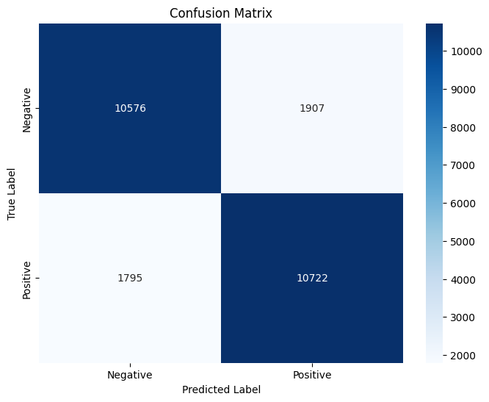
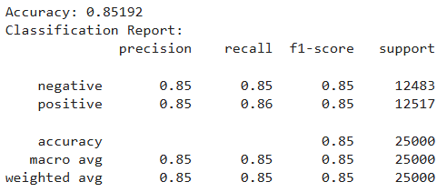
Accuracy: 85%
Confusion Matrix: Balanced performance with slight misclassification.
Classification Report: High precision and recall.

Slide 12
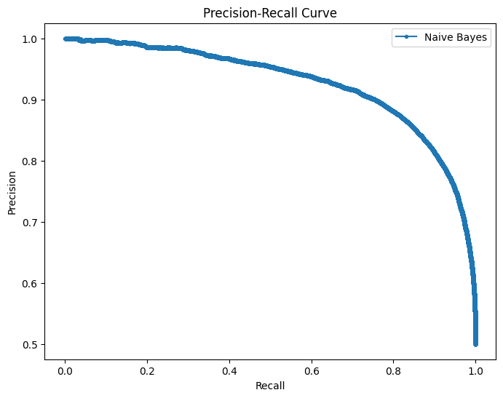
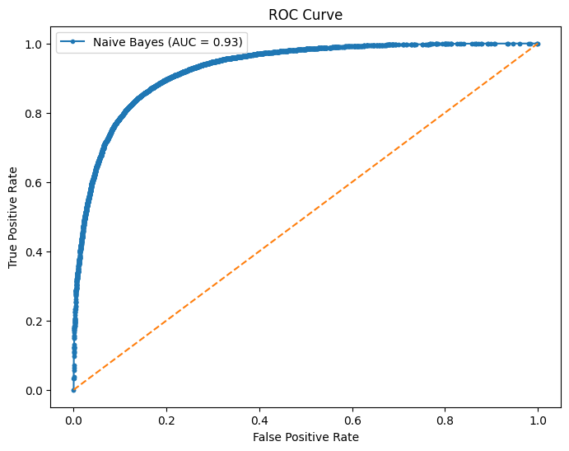
Precision-Recall Curve: Good performance in handling classes.
ROC Curve: High area under the curve (AUC).

Slide 13
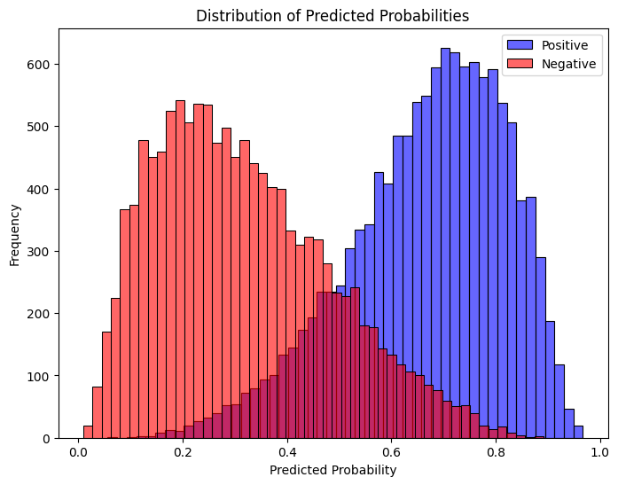
Distribution Plot: High degree of certainty in predictions.

Slide 14
Conclusion
Key steps: Text preprocessing, Naive Bayes classification, model evaluation.
Insights: Naive Bayes is effective for text classification with 85% accuracy.
Future improvements: More data, additional training parameters, real-world applications.

Slide 15
RESOURCE PAGE
N, L. (2019, March 9). IMDB dataset of 50K movie reviews. Kaggle. https://www.kaggle.com/datasets/lakshmi25npathi/imdb-dataset-of-50k-movie-reviews
Andrew L. Maas, Raymond E. Daly, Peter T. Pham, Dan Huang, Andrew Y. Ng, and Christopher Potts. (2011). Learning Word Vectors for Sentiment Analysis. The 49th Annual Meeting of the Association for Computational Linguistics (ACL 2011).
https://github.com/nishantjoshi-007/IMDB-project

